Slide 1
Architectural Frameworks
Parameswari Ettiappan

Slide 2
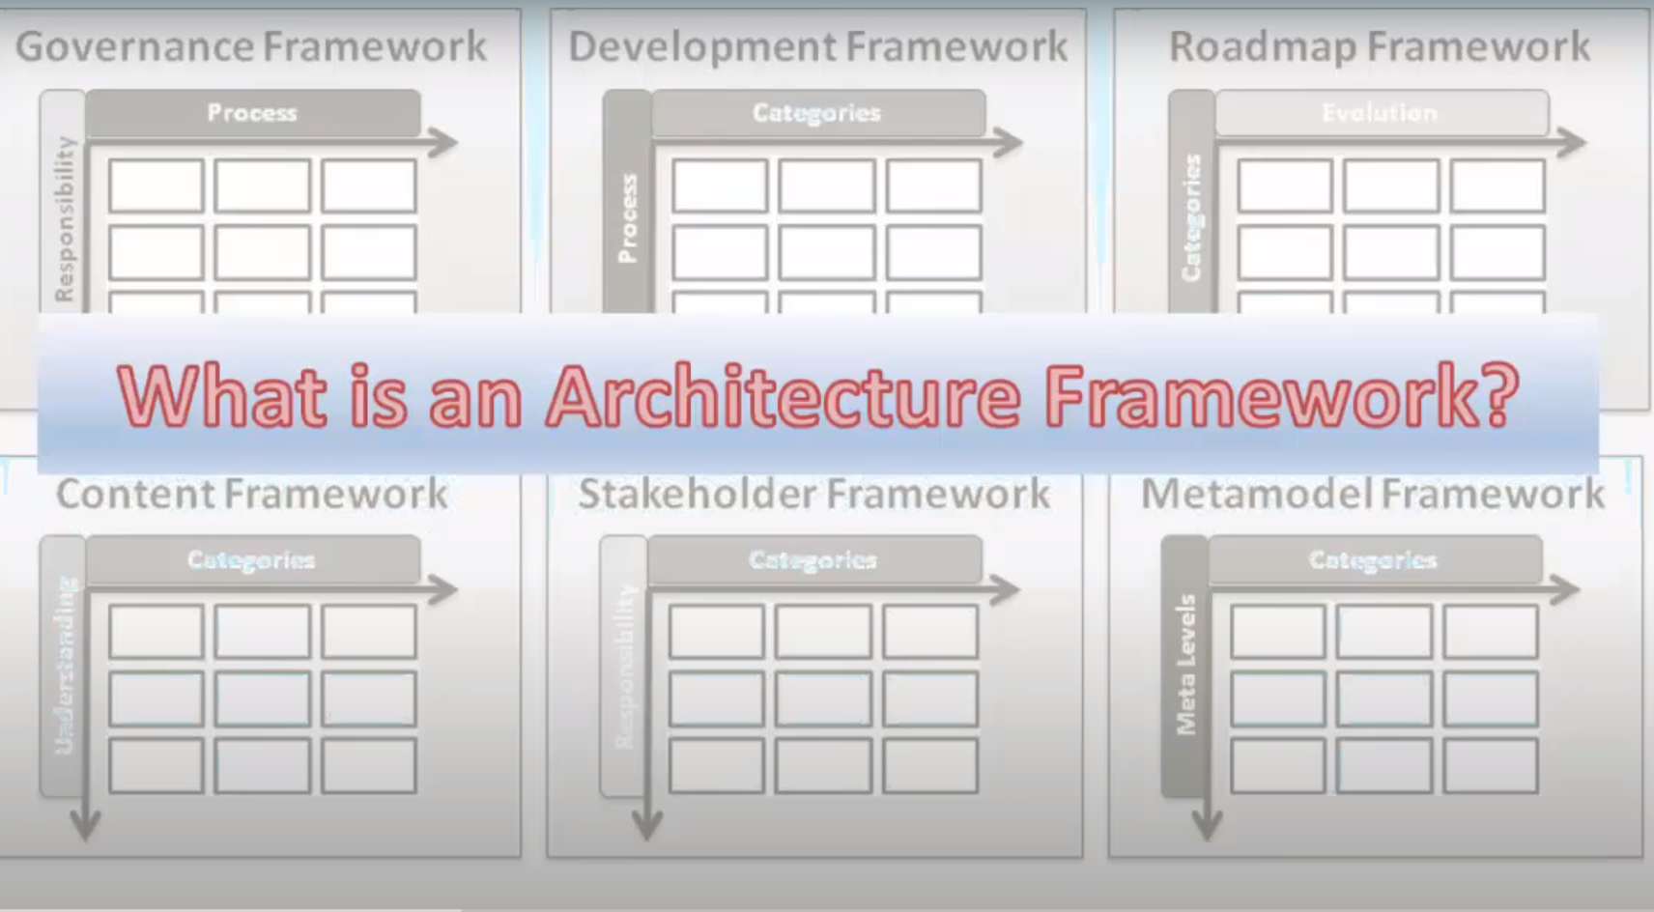

Slide 3
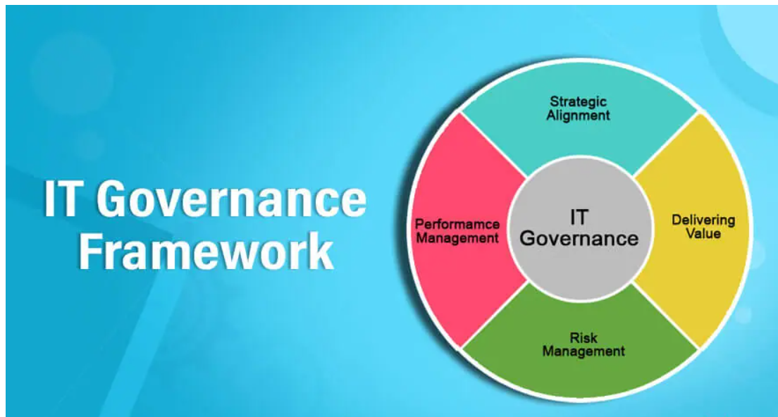
Governance Framework

Slide 4
Governance Framework
COBIT: the acronym refers Control Objectives for Information and Related Technology.
ITIL: it is most widely adopted IT service management framework in the world.
COSO: it is framework for corporate governance.
CMMI: this acronym stands for Capability Maturity Model integration.
FAIR: it refers Factor analysis of Information Risk. It is risk management frameworks help organizations analyze, understand, and measure information risk.

Slide 5
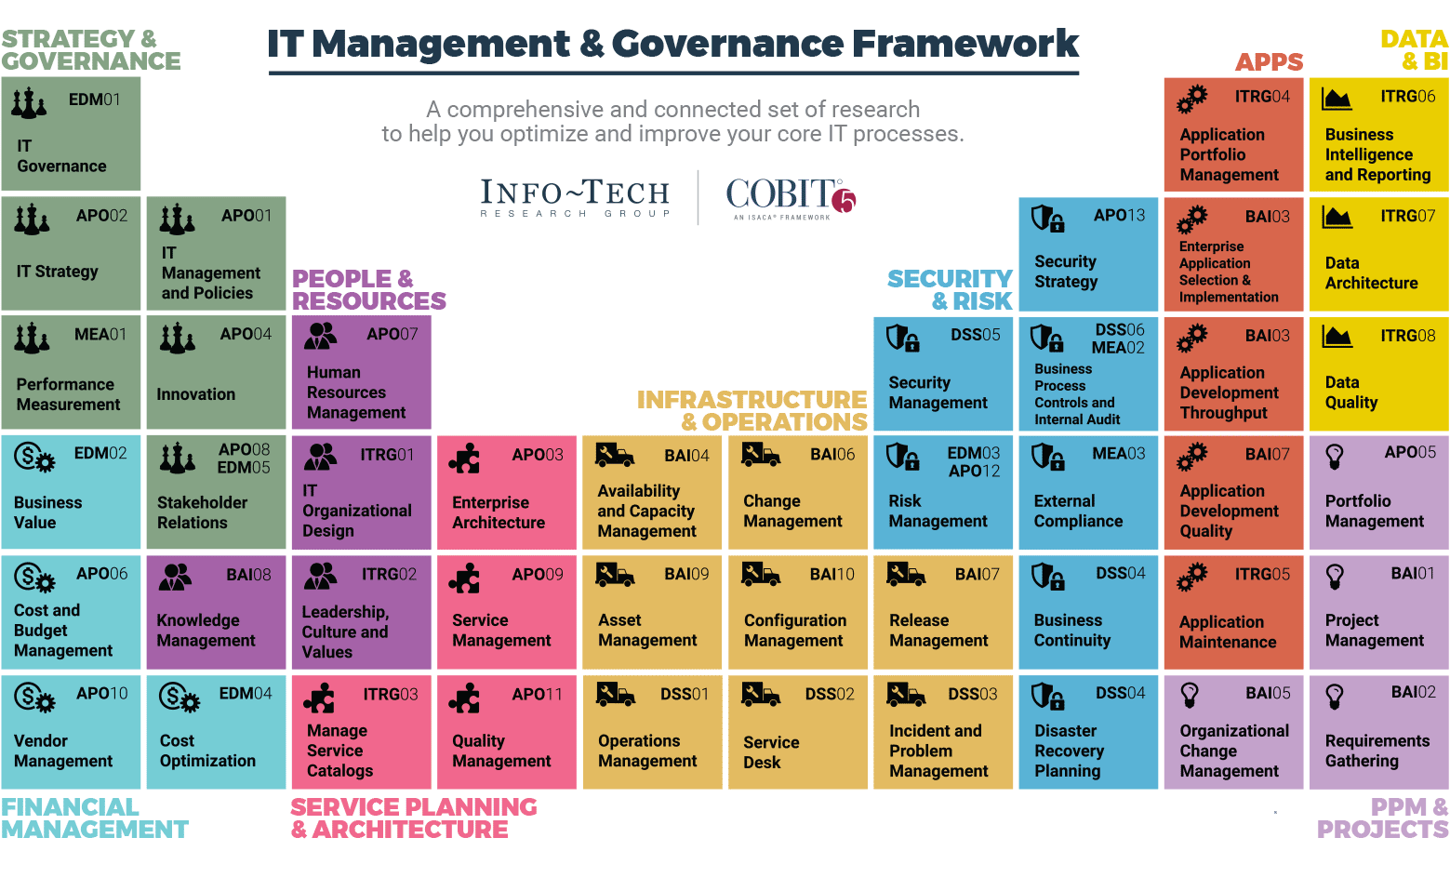
Governance Framework

Slide 6
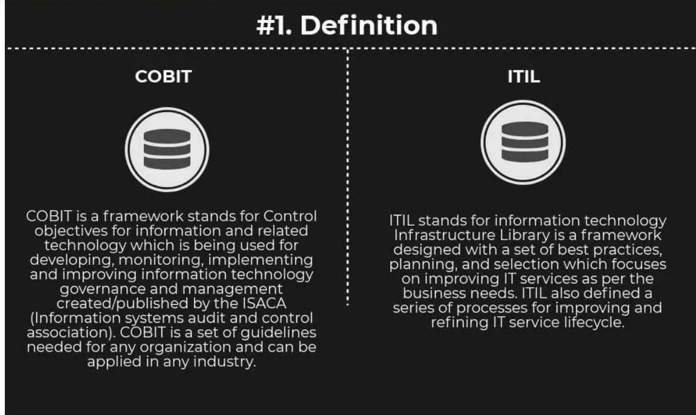
ITIL vs COBIT

Slide 7
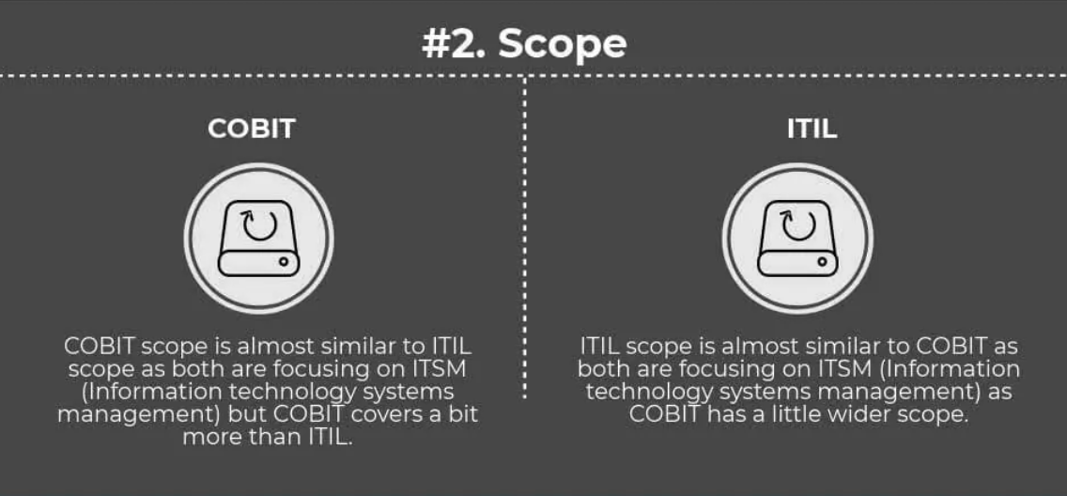
ITIL vs COBIT

Slide 8
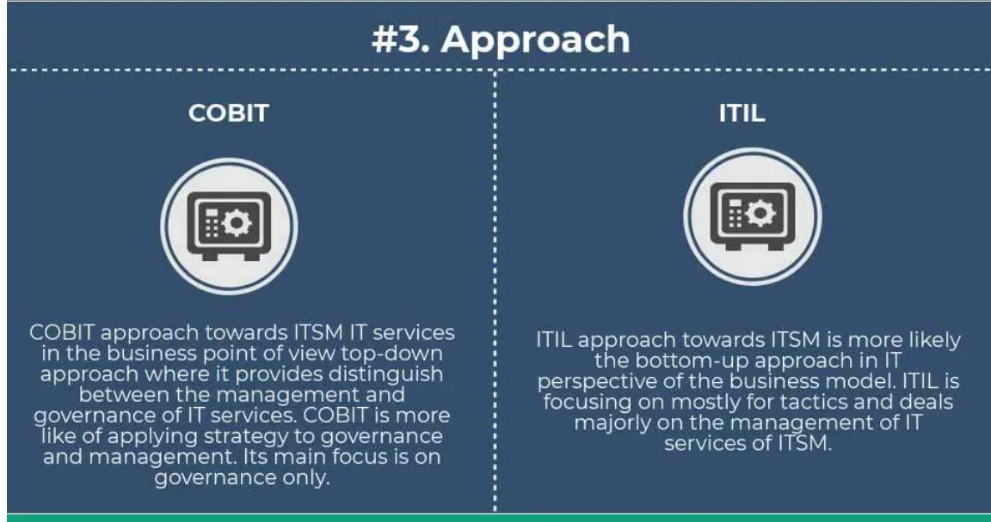
ITIL vs COBIT

Slide 9
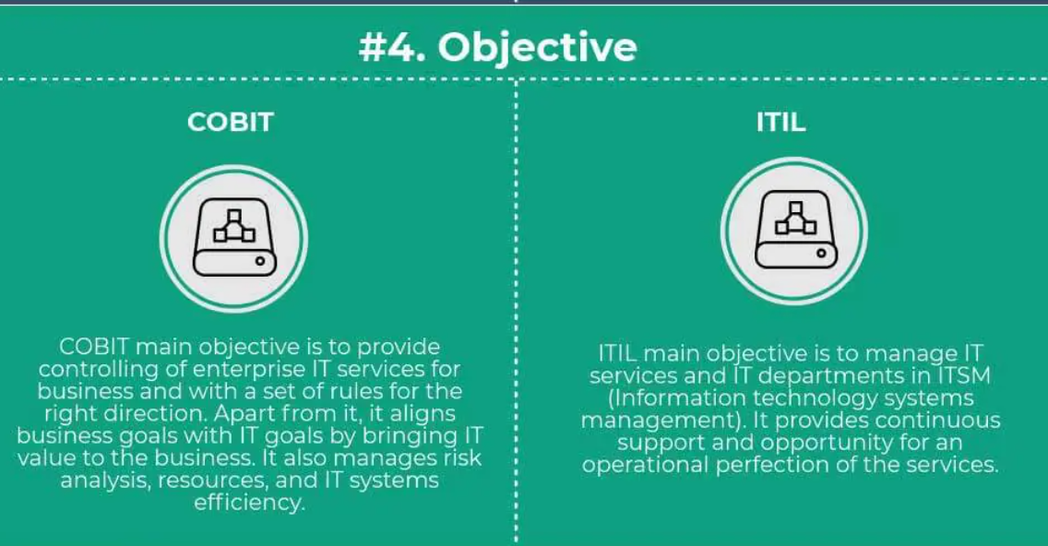
ITIL vs COBIT

Slide 10
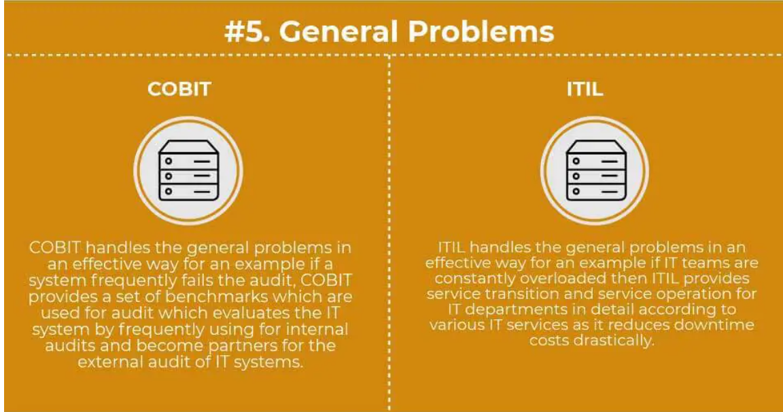
ITIL vs COBIT

Slide 11
RoadMap Framework
Agile
Scrum
Kanban
Scaled Agile Framework® (SAFe) roadmap

Slide 12
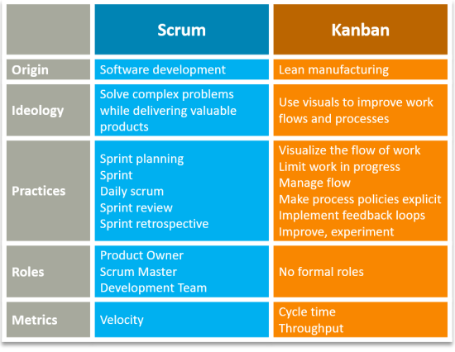
RoadMap Framework

Slide 13
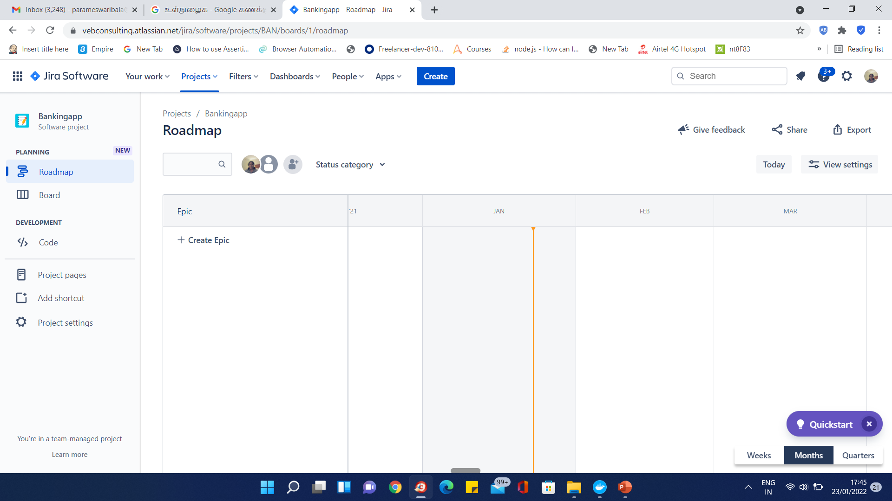
RoadMap Framework

Slide 14
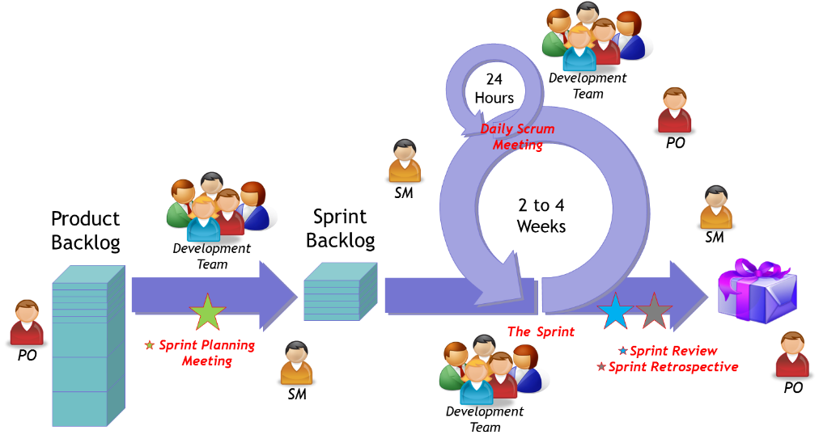
RoadMap Framework

Slide 15
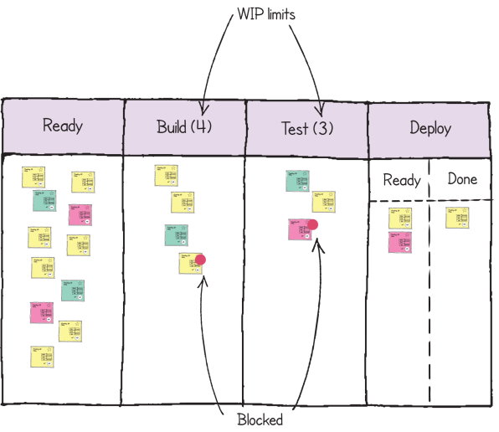
RoadMap Framework

Slide 16
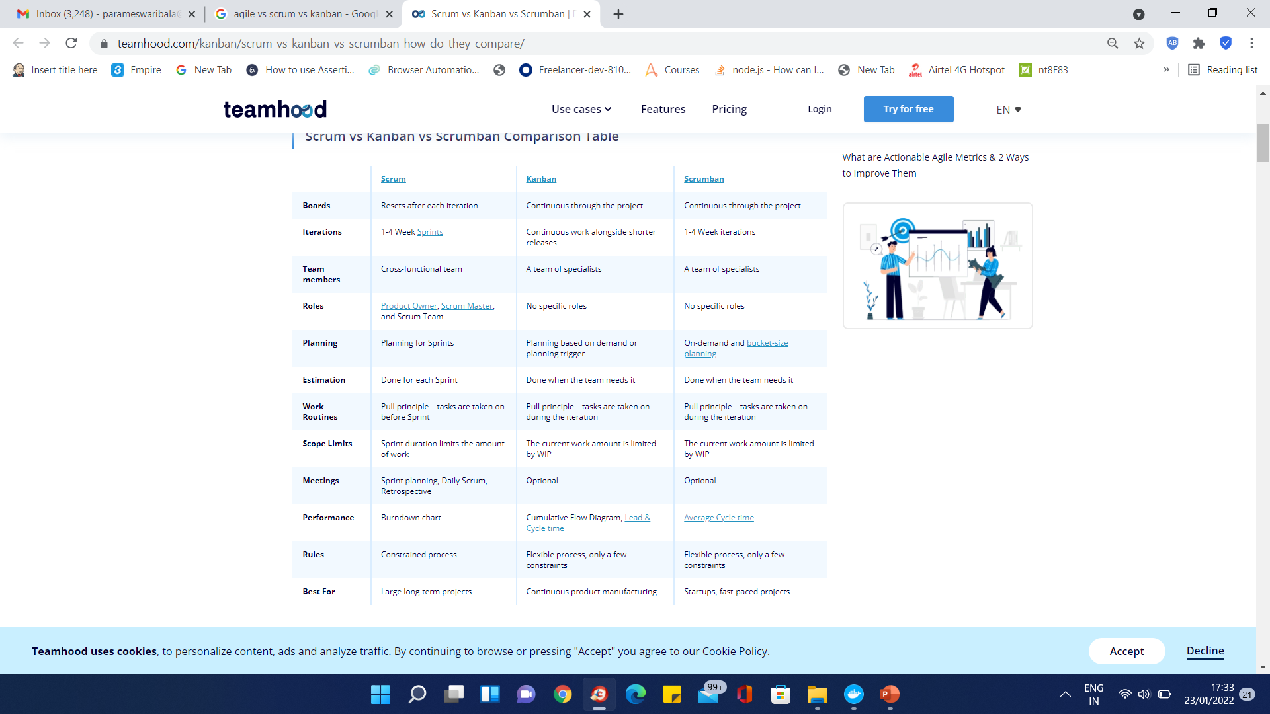
RoadMap Framework

Slide 17
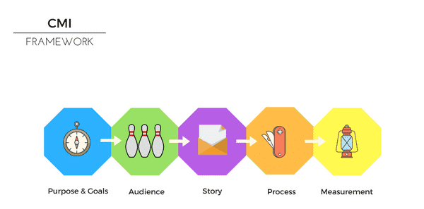
Content Marketing Framework

Slide 18
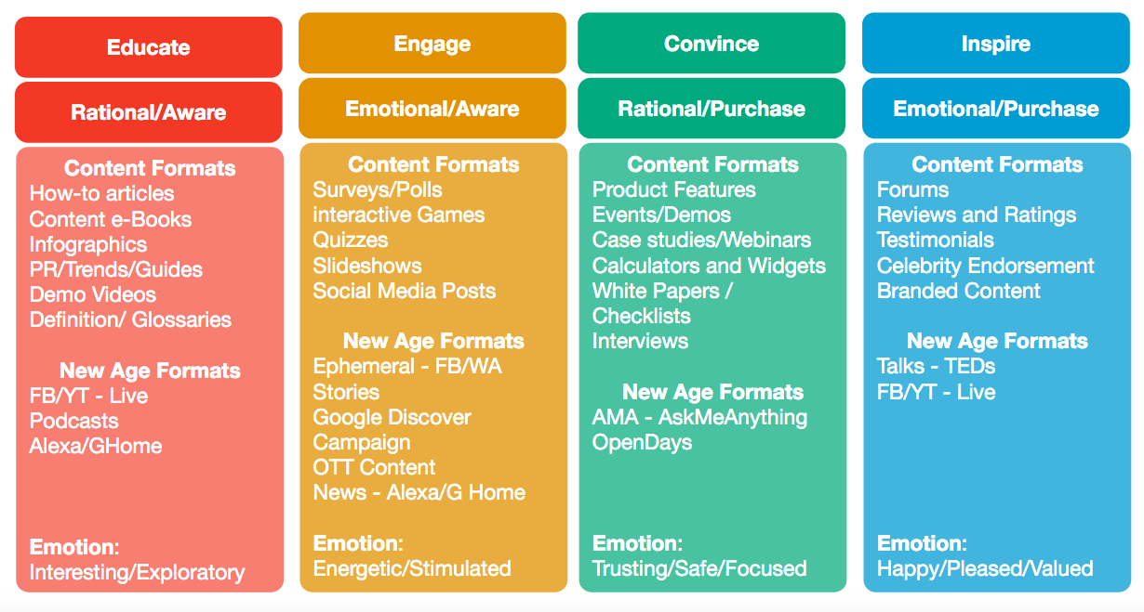
Content Marketing Framework

Slide 19
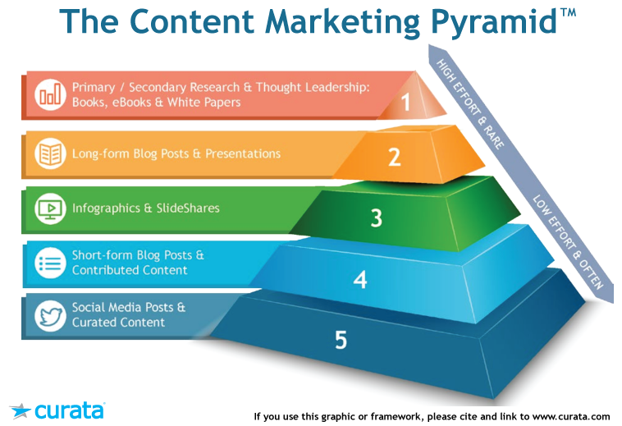
Content Marketing Framework

Slide 20
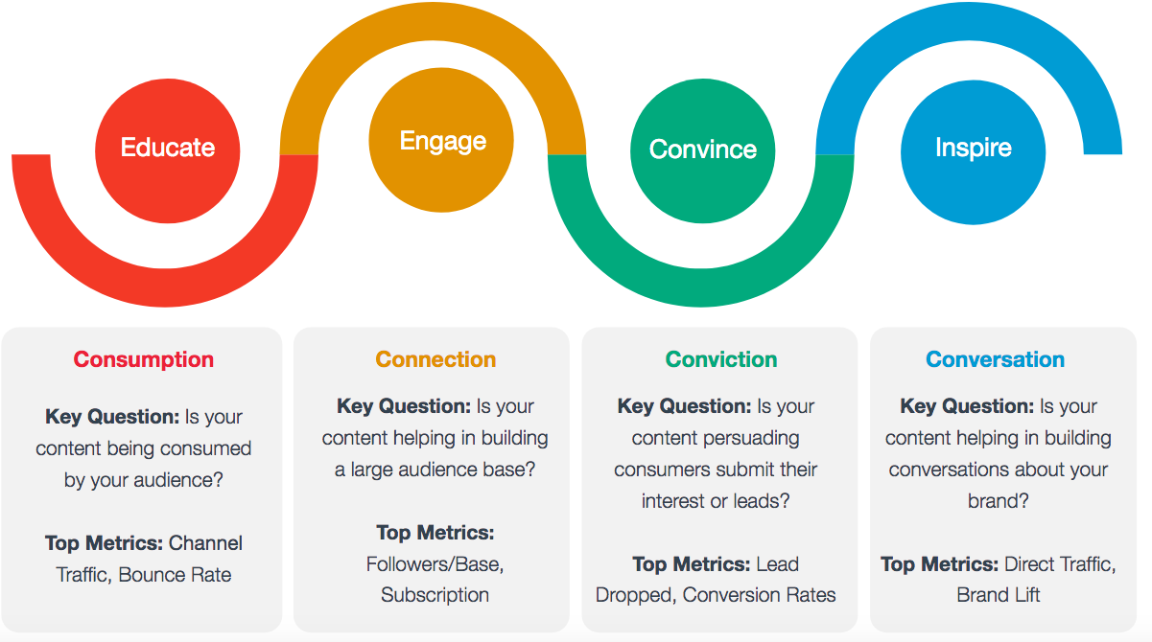
Content Marketing Framework

Slide 21
Content Marketing Framework
Simple warm acquisition(InVision)
B2B sales and lead generation(Auto Pilot)
Ecommerce (Simplified) (BeardBrand)
Evergreen forest(WebMD)
Competitive SEO (SlideBean)
“Trifecta” strategy (Nerd Wallet)

Slide 22
Stakeholder Framework
Stakeholder management ensures that stakeholders are appropriately involved in all aspects of the project, program or portfolio.
Its goals are to:
ensure that the views and attitudes of all stakeholders are understood;
influence stakeholders to be supportive of the work wherever possible;
maximize the impact of supportive stakeholders;
minimize the impact of unsupportive stakeholders.

Slide 23
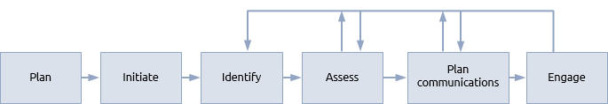
Stakeholder Framework
The identification of stakeholders can involve interviews, brainstorming, checklists, lessons learned etc.
Understanding the relationships between stakeholders and their different areas of interest is usually achieved through stakeholder mapping.
Common types of stakeholder include:
staff, contractors and suppliers who are performing the work;
individuals and groups who are affected by the creation of outputs or outcomes;
owners, customers or funders of the host organisation;
statutory, regulatory and governmental bodies.

Slide 24
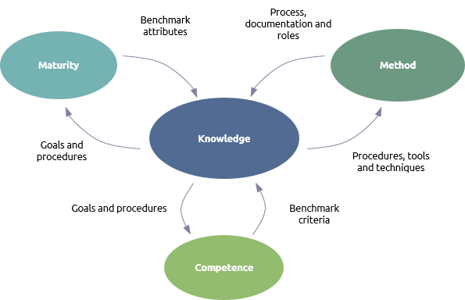
Stakeholder Framework
Praxis Framework (CMM Framework)

Slide 25
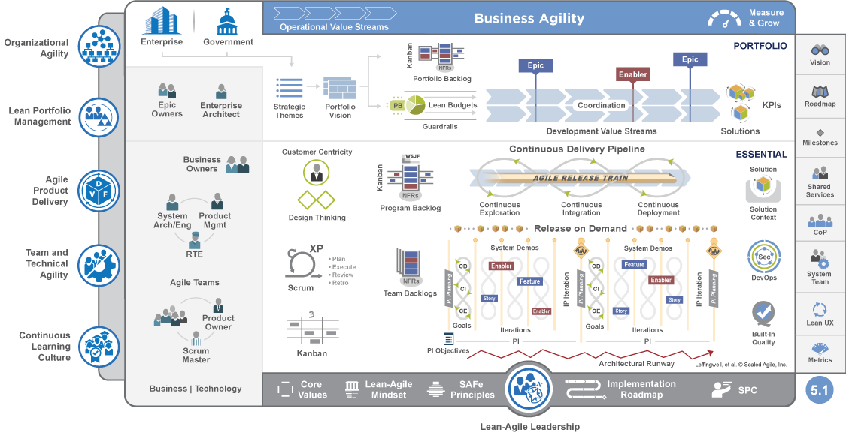
Scaled Agile

Slide 26
Why Scaled Agile
When a team is interested to implement an agile approach consistently across larger, multi-team programs and portfolios.
When multiple teams are running their own way of Agile implementation but regularly facing obstacles, delays, and failures.
When teams want to work independently.
When you want to scale Agile across the organization but not sure what new roles may be needed or what existing roles (i.e., management) need to change and how.
When you have attempted to scale the Agile across your organization but struggling in alignment to achieve uniform or consistent strategy across business departments from portfolio to program and team levels.
When an organization needs to improve its product development lead time and want to know how other companies have succeeded in scaling Agile with SAFe.

Slide 27
How different from Agile
decentralizing decisions.
creating transparency and alignment around strategic goals and how you organize work.
finding a balance between autonomous teams and cross-team dependencies.
changing virtually everything in the way you organize work.
delivering sooner and perfecting products “in the wild.”
collaborating throughout your business and with your customers.
updating, replacing, and integrating your information systems to enable transparent information flow throughout your company.

Slide 28
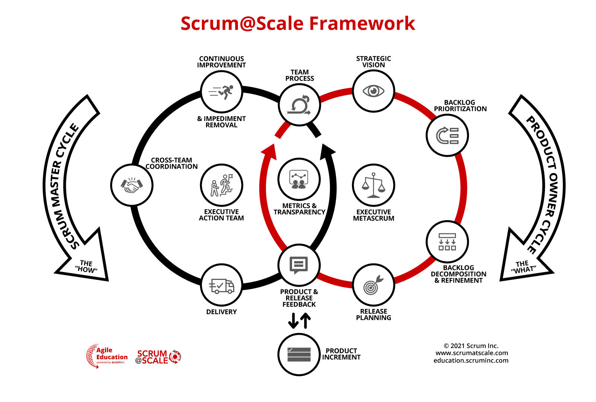
Scrum Scale Framework

Slide 29
Metamodel Framework
UML,SysML
Apache MetaModel

Slide 30
Enterprise Architecture Framework
An enterprise architecture framework (EA framework) defines how to create and use an enterprise architecture, which provides principles and practices for creating and using the architecture description of a system.
It provides tools and approaches that help enterprise architects to optimize different architecture domains across the enterprise the often fragmented legacy of processes (both manual and automated) into an integrated environment that is responsive to change and supportive of the delivery of the business strategy.

Slide 31
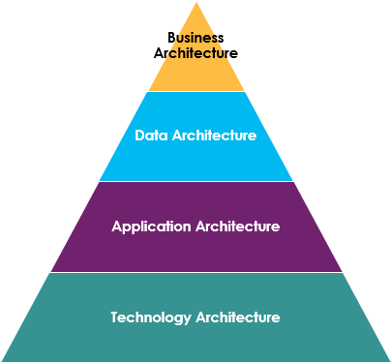
Enterprise Architecture Framework

Slide 32
The Major EA Frameworks
Architecture Framework is a prefabricated structure that organizes the system architecture of an enterprise into complementary projections called Views.
These industry-standard enterprise Architecture Frameworks include three different types of frameworks:
Template Framework – Zachman Framework
Content Framework, i.e. The Open Group Architecture Framework (TOGAF), the DoD Architecture Framework (DoDAF), the variants (MODAF and NAF), and
Unified Profile for EA frameworks from OMG (UDPM, UAF):

Slide 33
EA Template Framework
The EA Template Framework is any specific method or process for collecting, managing or using the information that it describes.
Zachman Framework

Slide 34
The Zachman Framework
It is aimed at organizing and analyzing data, solving problems, planning for the future, managing enterprise architecture and creating analytical models.
The six rows of the Zachman Framework matrix include:
Planner’s view (scope): This row is where you identify the business plan or strategy and establish what issue or concern will be addressed in the matrix.
Owner’s view (business concepts): The second row is where you will identify business needs and the resources the business will need to execute the plan.

Slide 35
The Zachman Framework
Designer’s view (system logic): The third row identifies how the plan will meet the business’ needs. This row corresponds to work done by systems analysts who handle the data, process flows and functions of business processes.
Engineer’s perspective (technology physics): The fourth row includes relevant information about how to implement the strategy and what tools, technology, materials and constraints the team will be working with.

Slide 36
The Zachman Framework
Technician’s perspective (component assembly): This row is where you will include representations of requirements for products, services or hardware.
User’s view (operations classes): The final row includes information about the functioning system and how it works in the IT or business environment.

Slide 37
The Zachman Framework
The six columns of the Zachman Framework template include all of the questions that you’ll ask during the process:
What (data): This is where you establish what business data, information and requirements are necessary for the project.
How (function): The “how” or “function” column identifies how processes work and impact the business.
Where (network): This column includes the “where,” which includes all system networks and relevant locations where business operations take place.

Slide 38
The Zachman Framework
Who (people): In column four you will identify the key stakeholders and determine all of the relevant personnel for the project.
When (time): Column five is where you will identify when and at what time business processes are performed in the company.
Why (motivation): The final column is where you will identify why you chose the final solution and what the motivation is behind the initiative or project.

Slide 39
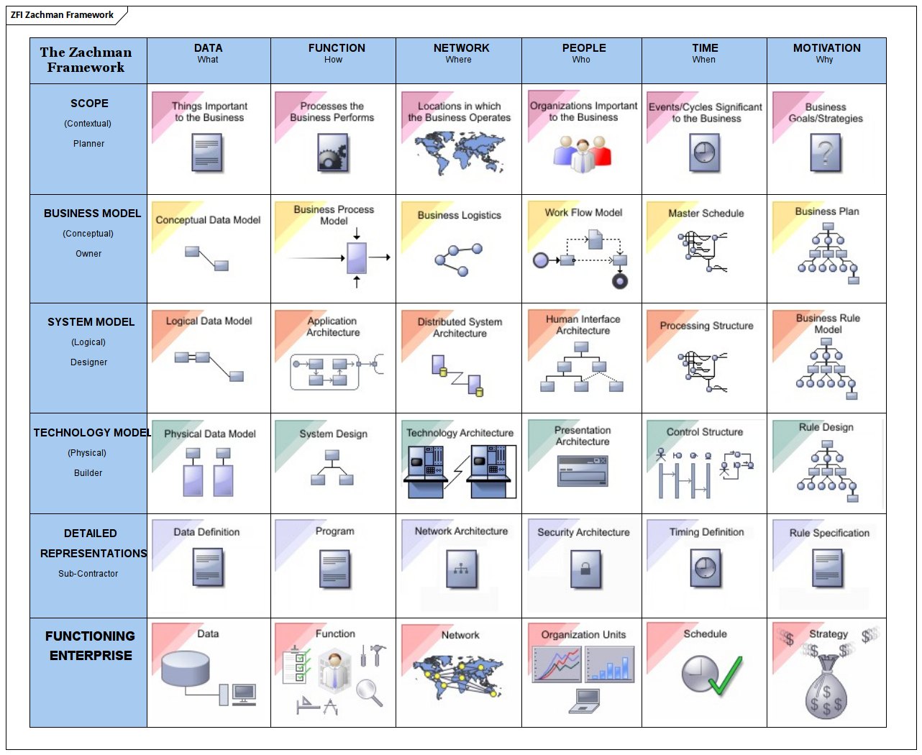
The Zachman Framework

Slide 40
TOGAF
The Open Group Architecture Framework (TOGAF) is a framework - a detailed method and a set of supporting tools for planning, developing, maintaining and gaining value from an Enterprise Architecture.
It may be used freely by any organization wishing to develop enterprise architecture for use within that organization.

Slide 41
TOGAF Components
The Architecture Development Method(ADM)
Purpose: How to manage enterprise architecture?
ADM Guidelines and Techniques
Purpose: How do we apply the ADM?
Architecture Content Framework: Deliverables, artifacts, building blocks
Purpose: How do we map all necessary information?
The Enterprise Continuum: The Architecture Repository
Purpose: How can we maximize recycling of existing architectures?
TOGAF Reference Models
Purpose: How do we build on industry-practice models?
The Architecture Capability Framework: Establishing an EA Capability
Purpose: How do we design our enterprise architecture?

Slide 42
TOGAF Architecture Development Method (ADM)
The TOGAF Architecture Development Method (ADM) provides a tested and repeatable process for developing architectures.
It is a generic method for architecture development that is designed to deal with most systems.
However, it will often be necessary to modify or extend the ADM to suit specific needs.
One of the tasks before applying the ADM is to review its components for applicability, and then tailor them as appropriate.

Slide 43
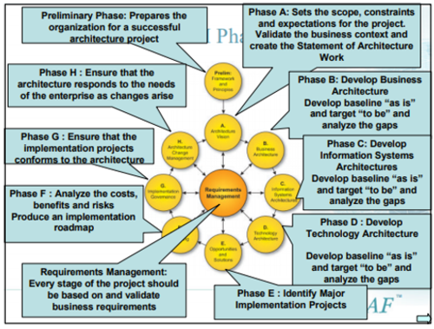
TOGAF Architecture Development Method (ADM)

Slide 44
TOGAF Architecture Development Method (ADM)
The Preliminary Phase describes the preparation and initiation activities required to prepare to meet the operational directive for a new architecture, including the definition of an organization-specific architecture framework and the definition of principles.
Phase A: Architecture Vision describes the initial phase of an architecture development cycle.
It includes information about defining the scope, identifying the stakeholders, creating the architecture vision, and obtaining approvals.

Slide 45
TOGAF Architecture Development Method (ADM)
Phase B: Business Architecture describes the development of a business architecture to support an agreed architecture vision.
Phase C: Information Systems Architectures describes the development of information systems architectures for an architecture project, including the development of data and application architectures.

Slide 46
TOGAF Architecture Development Method (ADM)
Phase D: Technology Architecture describes the development of the technology architecture for an architecture project.
Phase E: Opportunities and Solutions conducts initial implementation planning and identifies delivery vehicles for the architecture defined in the previous phases.
Phase F: Migration Planning addresses the formulation of a set of detailed sequences of transition architectures with a supporting implementation and migration plan.

Slide 47
TOGAF Architecture Development Method (ADM)
Phase G: Implementation Governance provides an architectural oversight of the implementation.
Phase H: Architecture Change Management establishes procedures for managing change to the new architecture.
Requirements Management examines the process of managing architecture requirements throughout the ADM

Slide 48
Architecture Description Framework (ADF) for
Enterprise Applications

Slide 49
ADF
Among the various steps in EA definition, the focus is to prescribe the right description framework for project architecture and LOB architecture

Slide 50
Need for the “right” description of architecture of enterprise applications
The architecture should describe the whole system at different levels of granularity depending on the hierarchy level of stakeholder.
The architecture should describe different architectural aspects of the system focusing one at a time so as to help separate concerns of the stakeholders
The software architecture of the system should take into account the enterprise and LOB level standards as well as architectural principles.
To achieve the above, the Architecture Description Framework (ADF) should
Provide guidelines and best practices for easy adoption
Provide tight coupling between the LOB target architecture and project architectures

Slide 52
LOB Architecture Models

Slide 53
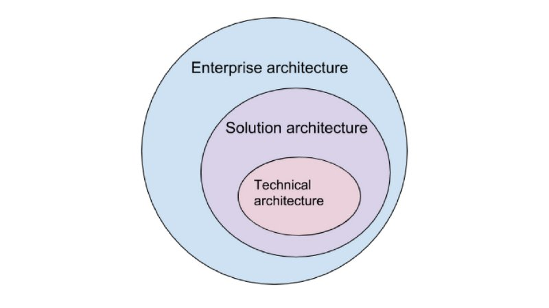
Solution architecture in the context of the enterprise and technical architecture

Slide 55
Building Blocks

Slide 56
Building Blocks

Slide 57
Building Blocks

Slide 58
Building Blocks

Slide 59
Building Blocks

Slide 60
Building Blocks

Slide 61
Building Blocks

Slide 62
Enterprise Understanding

Slide 63
Architecture Planning

Slide 64
Business Architecting

Slide 65
Technical Architecting

Slide 66
Architecture Validation

Slide 67
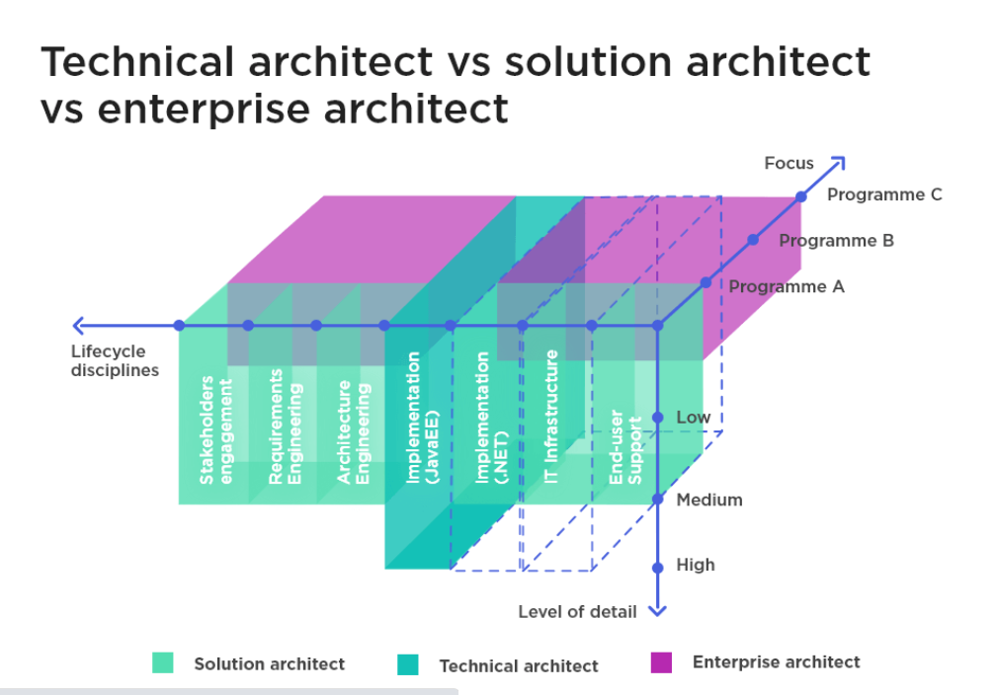
Solution architecture in the context of the enterprise and technical architecture

Slide 68
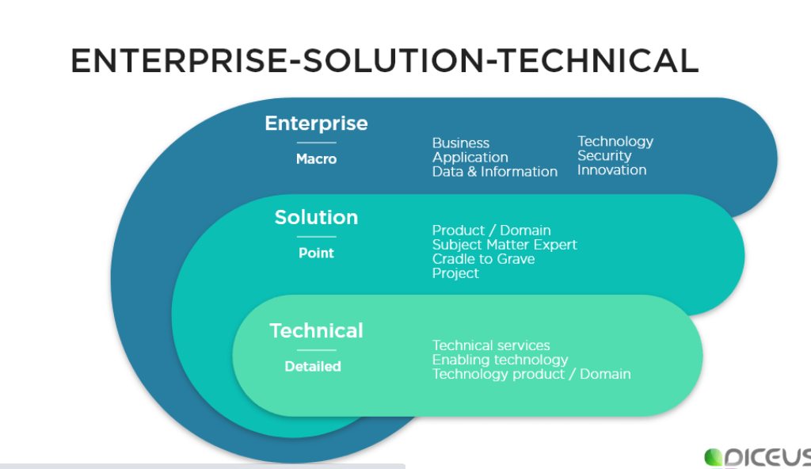
Solution architecture in the context of the enterprise and technical architecture

Slide 69
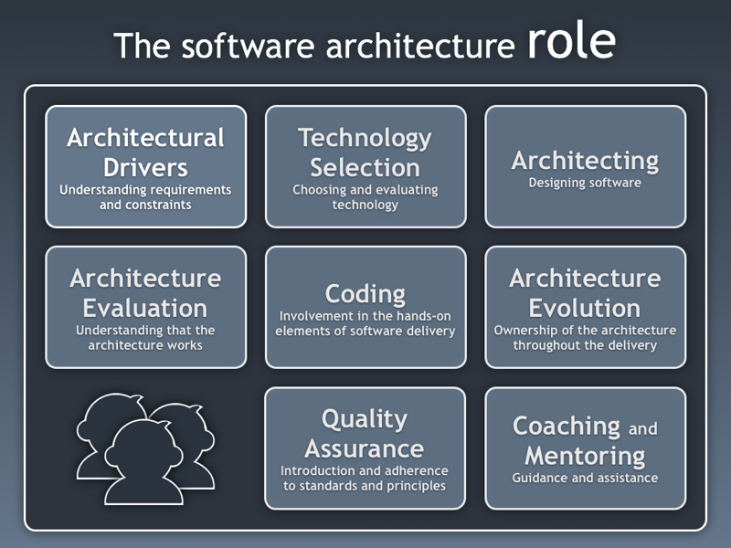

Slide 70
Types of software architects
Architect type | Strategic thinking | System interactions | Communication | Design
enterprise architect | across projects | highly abstracted | across organization | minimal, high level
solutions architect | focused on solution | very detailed | multiple teams | detailed
application architect | component re-use, maintainability | centered on single application | single project | very detail

Slide 71
Questions

Slide 72
Module Summary
Determining the Right Framework
Best Practices and Lessons Learned

